Slide 1
SDP PROJECT
PRESENTATION
SEM 6

Slide 2
TABLE OF CONTENTS
01
04
About the Project
Sneak Peek
02
05
Major Requirements
Project Stages
03
Project Goals
Movie Recommender System –
FSD + ML
A peek at how our website would look like
Movie Datasets, User Info & Third Party Movie Database
3 Major Stages of projects
Personalization, Engagement, Accuracy and Scalability

Slide 3
MOVIE RECOMMENDATION SYSTEM
The Movie Recommendation System is designed to revolutionize user engagement by delivering personalized movie suggestions based on individual preferences and viewing history.

Slide 4
MAJOR REQUIREMENTS
MOVIE DATASET
USER EXPERIENCE
USER INFORMATION
Comprehensive dataset of movies having enough attributes to analyze similarities between movies
An intuitive and responsive React-based frontend for a seamless user experience.
To deliver personalized experience.

Slide 5
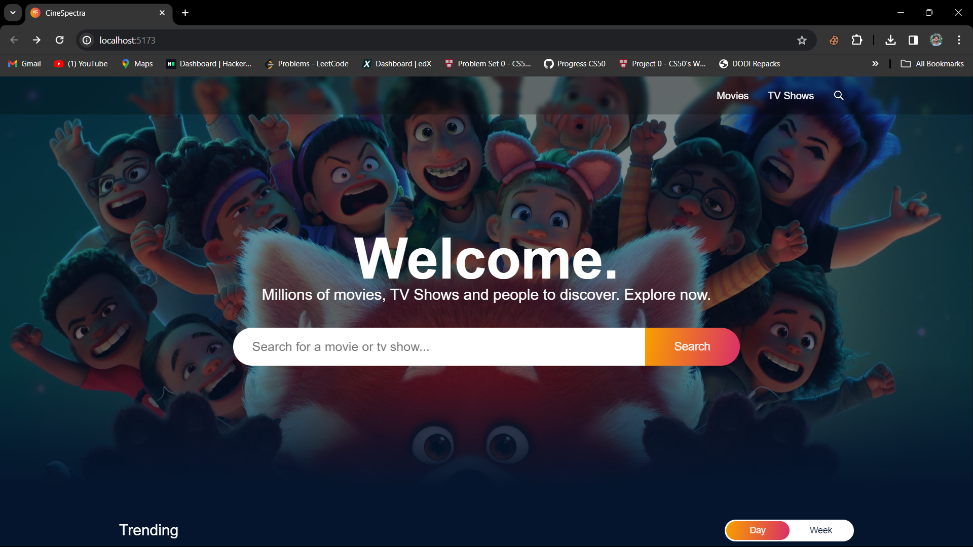
SNEAK PEEK

Slide 6
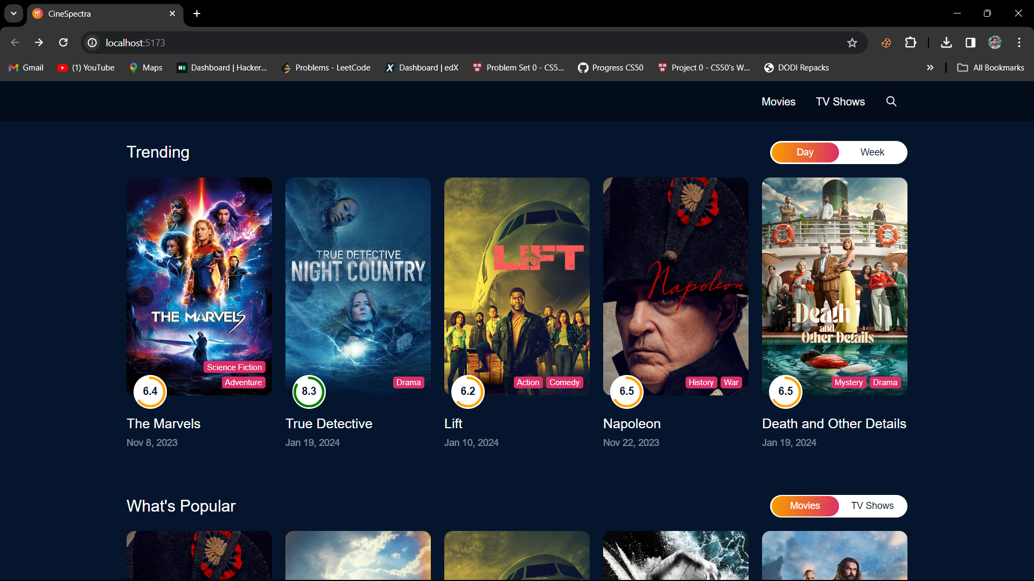

Slide 7
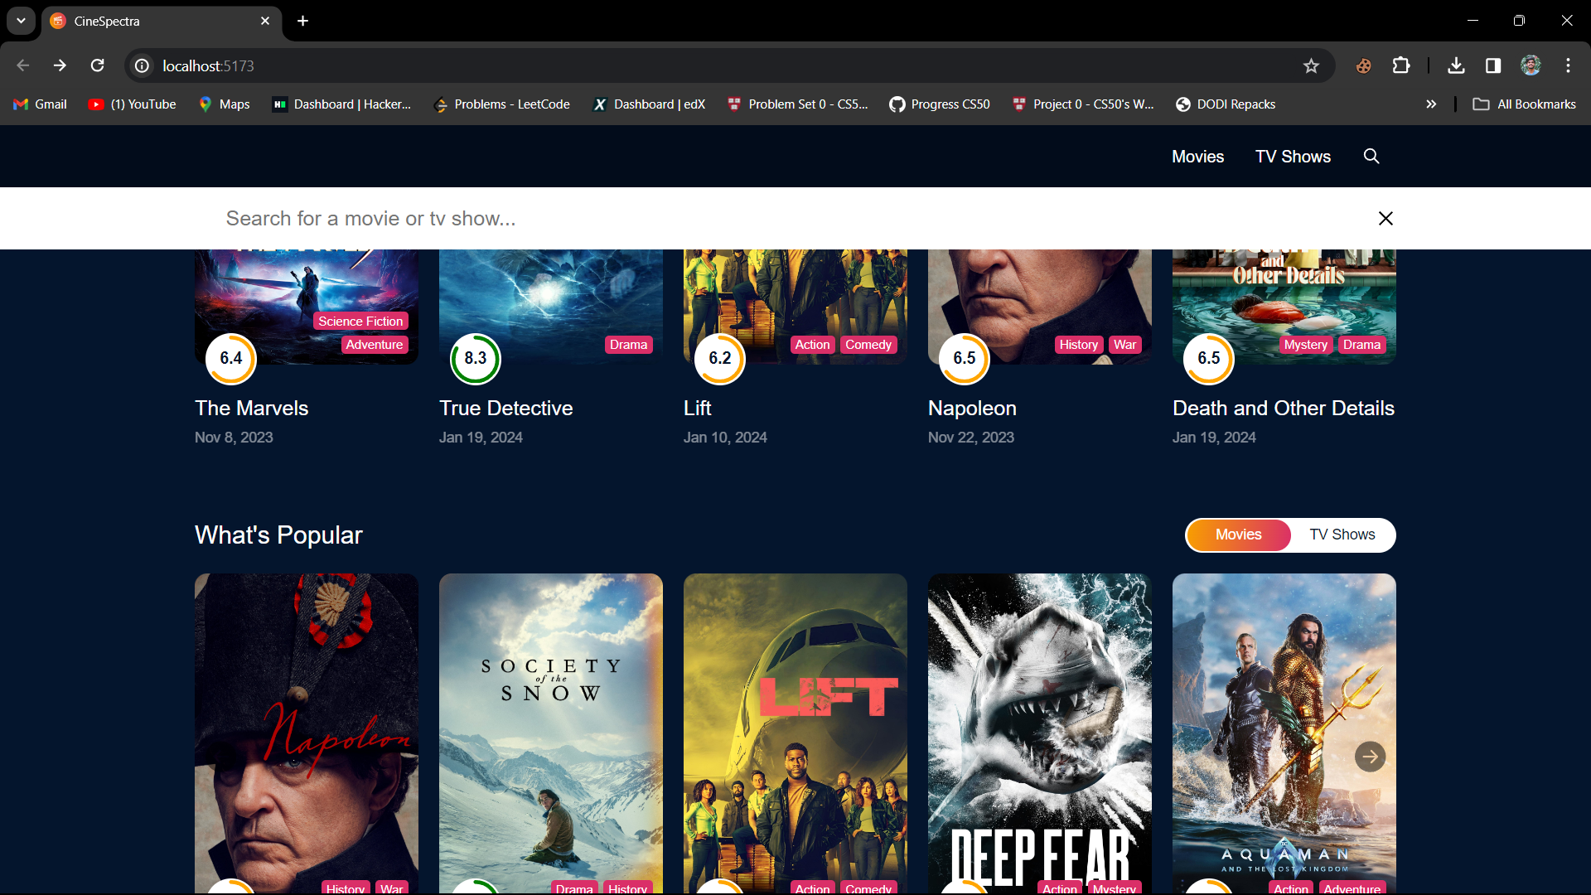

Slide 8
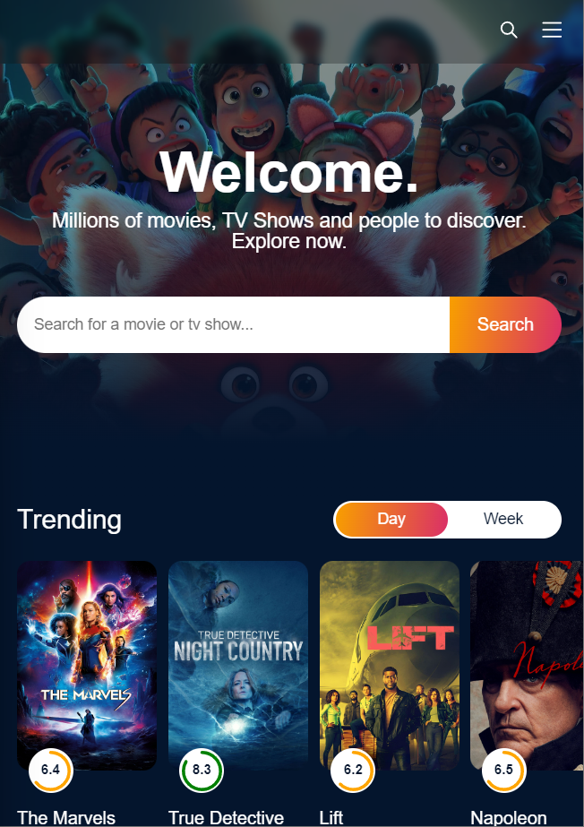
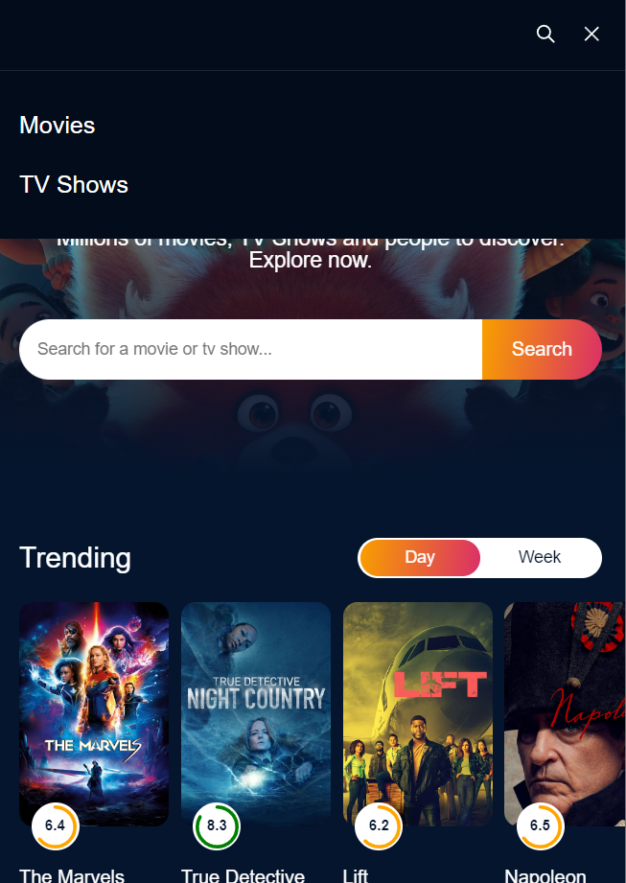
MOBILE VIEW

Slide 9
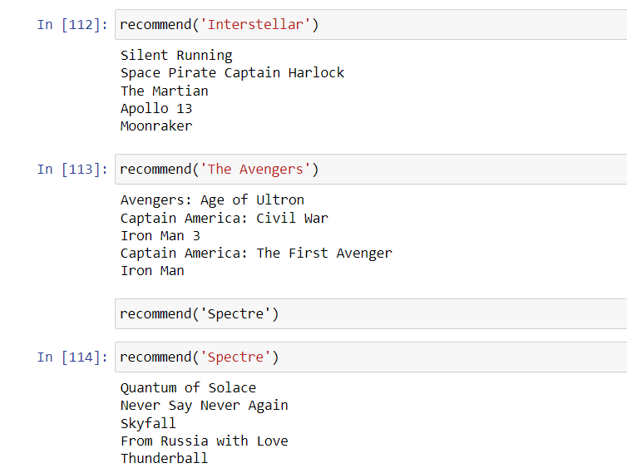
RECOMMEND FUNCTION

Slide 10
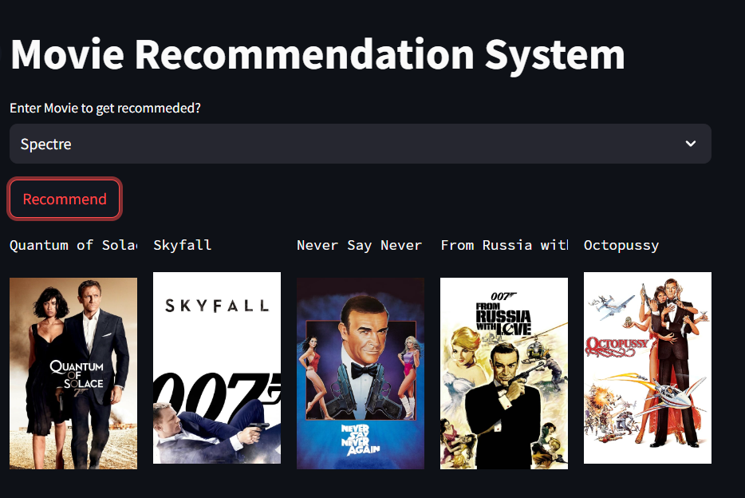
DEMO CREATED USING STREAMLIT

Slide 11
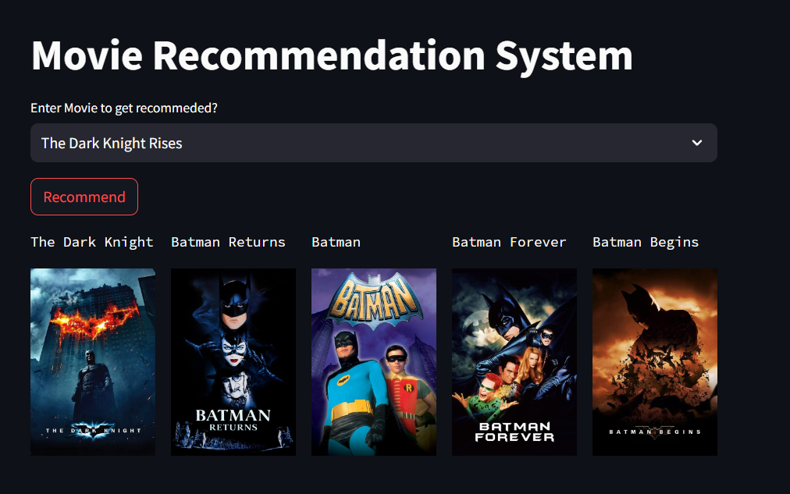

Slide 12
PROJECT STAGES
STEP 2
STEP 1
STEP 3
Implement movie recommendation algorithm using Python libraries along with dataset analysis
Create a single page React Application that can show details of movies(Frontend)
Combine both Frontend and Backend

Slide 13
THANKS!

